Slide 1






React – JS UI Library
Creating React Components with JSX and Babel
ReactJS
SoftUni Team
Technical Trainers
Software University
http://softuni.bg

Slide 2



Table of Contents
ReactJS – Overview
In-Browser Transpilation
Setup a Server-Side Build
Creating JSX Components

Slide 3
Have a Question?
sli.do #react

Slide 4
ReactJS – Overview
A JS Library for Building User Interfaces

Slide 5
What is React?
React (ReactJS / React.js) – https://facebook.github.io/react/
A JavaScript library for building user interfaces (UI)
Open-source, declarative, component-based, by Facebook
class HelloMessage extends React.Component {
render() {
return <div>Hello {this.props.name}</div>;
}
}
ReactDOM.render(<HelloMessage name="Maria" />,
document.getElementById('container'));

Slide 6



Setup React in the Browser

Slide 7
Running React in the Browser
In-browser React transpilation with "babel-standalone"
<script src="https://unpkg.com/react/dist/react.js"></script>
<script src="https://unpkg.com/react-dom/dist/react-dom.js"></script>
<script src="https://unpkg.com/babel-standalone"></script>
<div id="app">A React component will be rendered here</div>
<script type="text/babel">
ReactDOM.render(<div>Hello, React!</div>,
document.getElementById('app'));
</script>

Slide 8
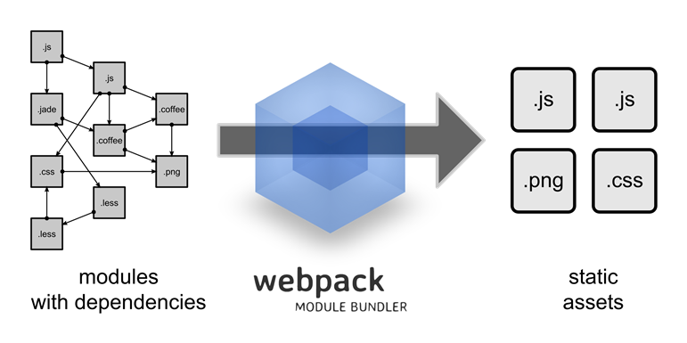
Setup React Server-Side Build
Configuring the Development Environment

Slide 9
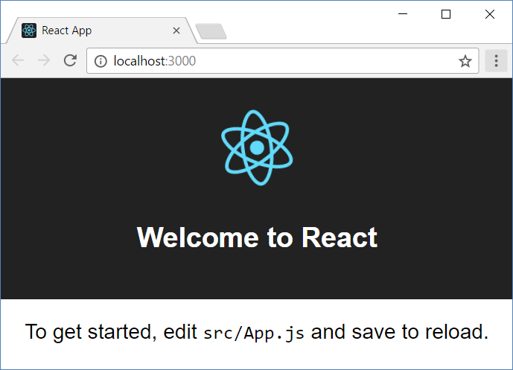
Install and Run the React App Creator
Install the React app creator (on-time global install):
Run the React app creator (this is very slow: ~5-10 minutes!)
Starts your React app from the command line
Browse you app from http://localhost:3000
npm -g install create-react-app
create-react-app react-example
npm start

Slide 10
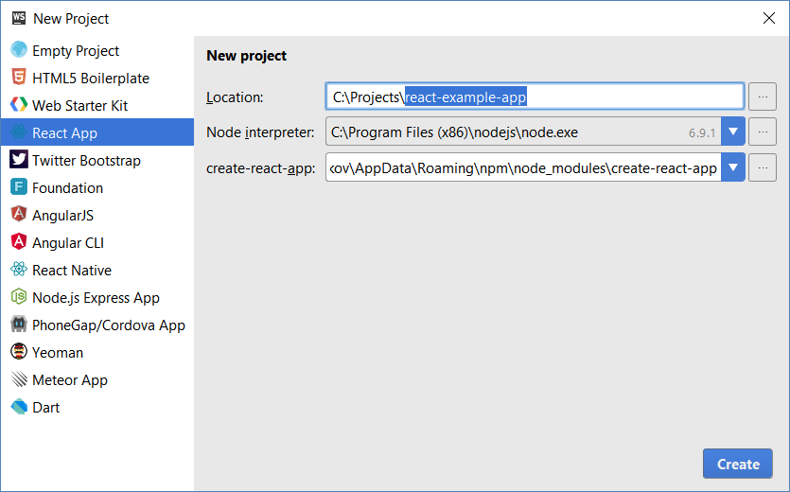
React Apps with WebStorm

Slide 11
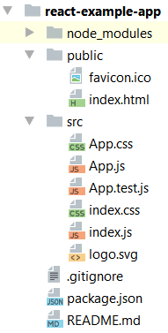
React App Structure
package.json – project configuration
Module name, dependencies, build actions
index.html
App main HTML file
index.js
App main JS file (startup script)
App.js, App.css, App.test.js
React component "App"

Slide 12



Creating JSX Components
JSX
component

Slide 13
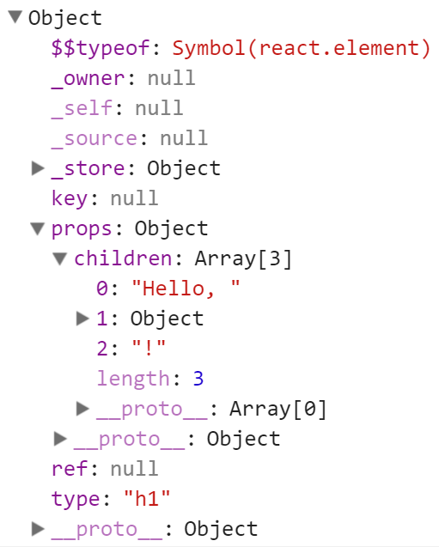
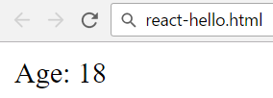
What is JSX?
JSX is a React's syntax for mixing HTML with JavaScript
let element =
<h1>Hello, <b>React</b>!</h1>;
console.dir(element);
let age = 18;
let ageElement =
<p>Age: {age}</p>;
ReactDOM.render(ageElement,
document.getElementById('app'));

Slide 14
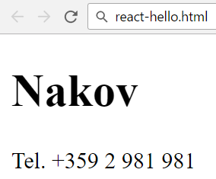
Creating a JSX Component (with Class)
class Person extends React.Component {
render() {
return (
<div>
<h1>{this.props.person}</h1>
<p>Tel. {this.props.phone}</p>
</div>
)
}
}
ReactDOM.render(
<Person person="Nakov"
phone="+359 2 981 981" />,
document.getElementById('app')
);

Slide 15
Creating a JSX Component (with Object)
let Person = React.createClass({
render: function() {
return (
<div>
<h1>{this.props.person}</h1>
<p>Tel. {this.props.phone}</p>
</div>
)
}
});
ReactDOM.render(
<Person person="Nakov"
phone="+359 2 981 981" />,
document.getElementById('app')
);

Slide 16

Creating a JSX Component (with Function)
function ErrorBox(props) {
let css = {
color: 'red', fontWeight: 'bold',
border: '1px solid red', padding: '8px'
};
return <div style={css}>Error: {props.msg}</div>;
}
ReactDOM.render(
<ErrorBox msg='Invalid login!' />,
document.getElementById('app')
);

Slide 17
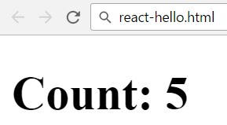
Component Holding a State
let Counter = React.createClass({
getInitialState: function() {
return { count: this.props.start }
},
render: function() {
return <h1>Count: {this.state.count}</h1>
}
});
ReactDOM.render(
<Counter start="5" />,
document.getElementById('app'));

Slide 18
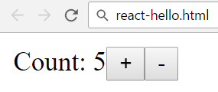
Component Holding a State + Events
let Counter = React.createClass({
getInitialState: function() {
return { count: Number(this.props.start) }
},
incrementCount: function() { this.changeCount(+1) },
decrementCount: function() { this.changeCount(-1) },
changeCount: function(delta) {
// This will update the component UI
this.setState({
count: this.state.count + delta
});
},

Slide 19
Component Holding a State + Events
render: function() {
return <div>
Count: {this.state.count}
<button type="button" onClick=
{this.incrementCount}>+</button>
<button type="button" onClick=
{this.decrementCount}>-</button>
</div>
}
});
let counter = <Counter start="5" />;
ReactDOM.render(counter, document.getElementById('app'));

Slide 20
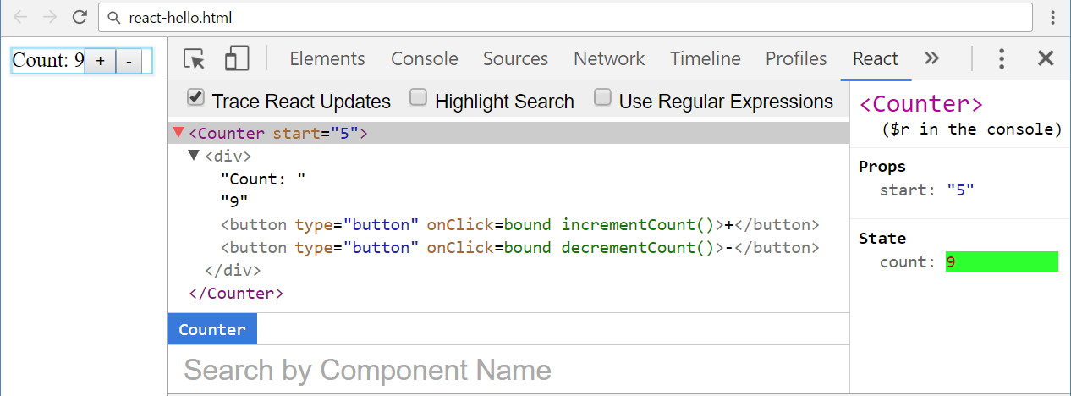
Using the React Developer Tools
React Dev Tools – https://github.com/facebook/react-devtools

Slide 21
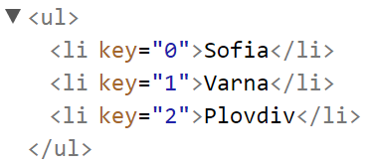
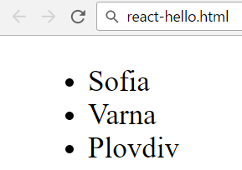
Rendering a List of Items (with Loop)
let List = React.createClass({
render: function() {
let items = [];
for (let i in this.props.items)
items.push(<li key={i}>{this.props.items[i]}</li>);
return <ul>{items}</ul>;
}
});
let towns = ["Sofia", "Varna", "Plovdiv"];
let list = <List items={towns} />;
ReactDOM.render(list, document.getElementById('app'));

Slide 22
Rendering a List of Items (with .map())
let List = React.createClass({
render: function() {
let items = this.props.items.map(function(item, i) {
return <li key={i}>{item}</li>;
});
return <ul>{items}</ul>;
}
});
let list = <List items={["Sofia", "Varna", "Plovdiv"]} />;
ReactDOM.render(list, document.getElementById('app'));

Slide 23
Rendering a List of Items (Inline)
let List = React.createClass({
render: function() {
return (
<ul>
{this.props.items.map(function(item, i) {
return <li key={i}>{item}</li>;
})}
</ul>
)
}
});
ReactDOM.render(
<List items={["Sofia", "Varna", "Plovdiv"]} />,
document.getElementById('app'));

Slide 24
Rendering a Table of Rows
let Table = React.createClass({
render: function() {
let titles =
this.props.columns.map(function(column, i) {
return <th key={i}>{column}</th>;
});
let rows = this.props.rows.map(function(row, r) {
return <tr key={r}>{row.map(function(col, c){
return <td key={c}>{col}</td>
})}</tr>;
});

Slide 25
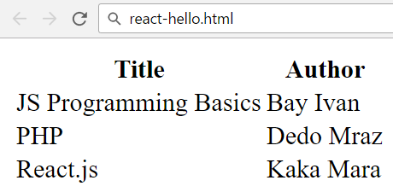
Rendering a Table of Rows (2)
return (
<table>
<thead><tr>{titles}</tr></thead>
<tbody>{rows}</tbody>
</table>
)
}
});
let books = [["JS Programming Basics","Bay Ivan"],
["PHP","Dedo Mraz"], ["React.js","Kaka Mara"]];
ReactDOM.render(
<Table columns={["Title", "Author"]} rows={books} />,
document.getElementById('app'));

Slide 26
Rendering Forms (Controlled Component)
let PersonForm = React.createClass({
getInitialState: function() {
let name = this.props.name;
if (name == undefined) name = "";
let age = Number(this.props.age);
if (Number.isNaN(age)) age = 0;
return { name, age };
},
handleNameChange(event) {
this.setState({name: event.target.value});
},

Slide 27
Rendering Forms (Controlled Component) (2)
handleAgeChange(event) {
let age = Number(event.target.value);
if (Number.isNaN(age))
age = 0;
this.setState({ age });
},
handleFormSubmit(event) {
if (this.props.onsubmit)
this.props.onsubmit(this.state);
event.preventDefault();
},

Slide 28
Rendering Forms (Controlled Component) (3)
render: function() {
return <form onSubmit={this.handleFormSubmit}>
<label>Name:
<input type="text" value={this.state.name}
onChange={this.handleNameChange} />
</label>
<label>Age:
<input type="text" value={this.state.age}
onChange={this.handleAgeChange} />
</label>
<input type="submit" value="Submit" />
</form>
}
});

Slide 29
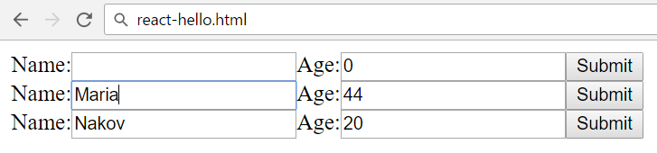
Rendering Forms (Controlled Component) (4)
ReactDOM.render(
<div>
<PersonForm />
<PersonForm onsubmit={editPerson} />
<PersonForm name="Nakov" age="20"
onsubmit={editPerson} />
</div>,
document.getElementById('app'));
function editPerson(personFormData) {
alert(JSON.stringify(personFormData));
}

Slide 30
Rendering Forms (Uncontrolled Component)
let PersonForm = React.createClass({
render: function() {
return <form onSubmit={this.handleFormSubmit}>
<label>Name:
<input type="text" defaultValue={this.props.name}
ref={e => this.nameField = e} />
</label>
<label>Age:
<input type="text" defaultValue={this.props.age}
ref={e => this.ageField = e} />
</label>
<input type="submit" />
</form>
},
Remember the undelying DOM element as field

Slide 31
Rendering Forms (Uncontrolled Component) (2)
handleFormSubmit: function(event) {
event.preventDefault();
let formData = {
name: this.nameField.value,
age: this.ageField.value
};
if (this.props.onsubmit)
this.props.onsubmit(formData);
}
});
Take the form field values from the underlying DOM elements

Slide 32
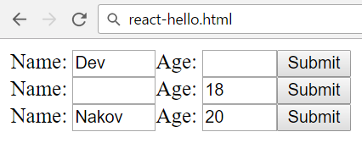
Rendering Forms (Uncontrolled Component) (3)
ReactDOM.render(
<div>
<PersonForm name="Dev" onsubmit={editPerson} />
<PersonForm age="18" onsubmit={editPerson} />
<PersonForm name="Nakov" age="20"
onsubmit={editPerson} />
</div>,
document.getElementById('app'));
function editPerson(personFormData) {
alert(JSON.stringify(personFormData));
}

Slide 33
React and jQuery
<script src="jquery.min.js"></script>
let Hello = React.createClass({
render: function() {
return <p>Hello, {this.props.name}</p>
}
});
let div = $('<div>').appendTo(document.body);
ReactDOM.render(<Hello name='Maria' />, div[0]);
div holds jQuery collection
div[0] holds DOM element

Slide 34

Practice: React and JSX Components
JSX
component
Live Exercises in Class (Lab)

Slide 35


Summary
ReactJS: open-source, declarative, component-based UI library for JS
React DOM uses JSX syntax
let HelloMsg = React.createClass({
render: function() {
return <p>Hello {this.props.name}</p>;
}
});
ReactDOM.render(<HelloMsg name="Maria" />,
document.getElementById('container'));

Slide 36









ReactJS
https://softuni.bg/courses/javascript-applications

Slide 37
License
This course (slides, examples, demos, videos, homework, etc.) is licensed under the "Creative Commons Attribution-NonCommercial-ShareAlike 4.0 International" license

Slide 38






Free Trainings @ Software University
Software University Foundation – softuni.org
Software University – High-Quality Education, Profession and Job for Software Developers
softuni.bg
Software University @ Facebook
facebook.com/SoftwareUniversity
Software University @ YouTube
youtube.com/SoftwareUniversity
Software University Forums – forum.softuni.bg

